Slide 1


SQL PROJECT
By
Sruthika
A Project on Pizza House Sales Analysis.

Slide 2


PROJECT SUMMARY
01
03
OBJECTIVE
ABOUT THE DATA SET
Analyzing sales records from a pizza restaurant, spanning one year.
Dataset has 48,620 sales transactions to analyze
Analyze pizza sales data
provide actionable insights on sales performance
customer preferences, and
revenue generation
02
04
FEATURES OF THE TOPIC
TOOLS USED
MYSQL for data querying and manipulation
Sub Query
Group by
Cumulative sum
Visualizations

Slide 3
PROBLEM STATEMENTS
1. Retrieve the total number of orders placed.
2. Calculate the total revenue generated from pizza sales.
3. Identify the highest-priced pizza.
4. Identify the most common pizza size ordered.
5. List the top 5 most ordered pizza types along with their quantities.
6. Join the necessary tables to find the total quantity of each pizza category ordered.
7. Determine the distribution of orders by hour of the day.
8. Join relevant tables to find the category-wise distribution of pizzas.
9. Group the orders by date and calculate the average number of pizzas ordered per day.
10. Determine the top 3 most ordered pizza types based on revenue.
11. Calculate the percentage contribution of each pizza type to total revenue.
12. Analyze the cumulative revenue generated over time.
13. Determine the top 3 most ordered pizza types based on revenue for each pizza category.

Slide 4
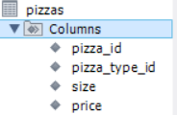
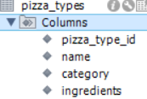
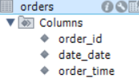
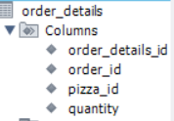
DATA SCHEMA

Slide 5
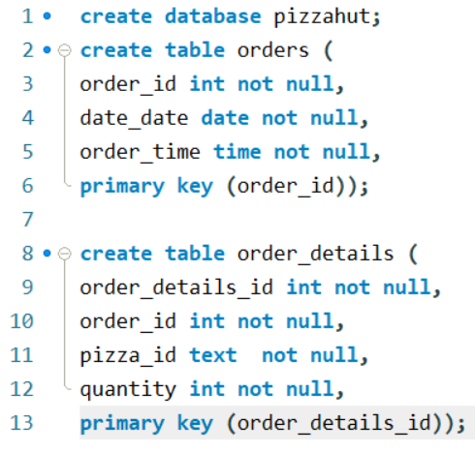
CREATING DATABASE AND TABLES

Slide 6
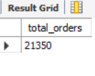
Retrieve the total number of orders placed

Slide 7
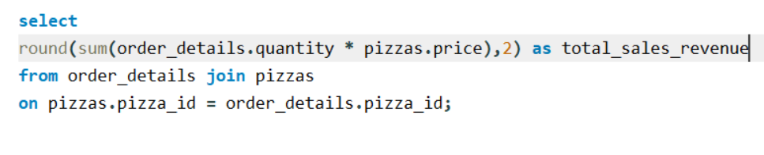
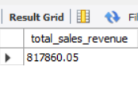
2.Calculate the total revenue generated from pizza sales

Slide 8
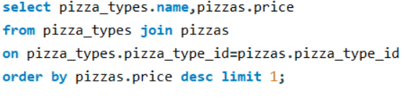
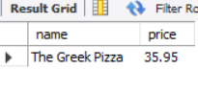
3.Identify the highest-priced pizza.

Slide 9
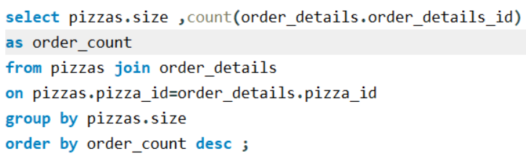
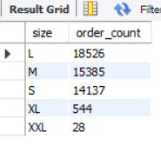
4.Identify the most common pizza size ordered.

Slide 10
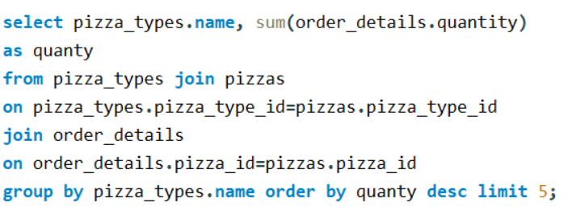
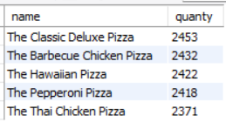
5. List the top 5 most ordered pizza types along with their quantities.

Slide 11
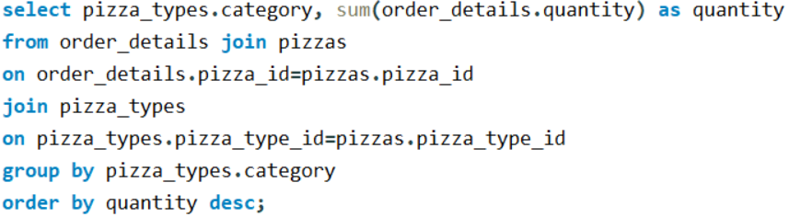
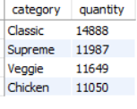
6. find the total quantity of each pizza category ordered.

Slide 12
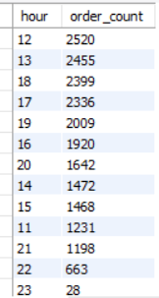
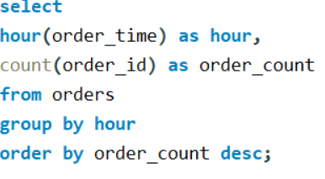
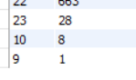
7. Determine the distribution of orders by hour of the day.

Slide 13
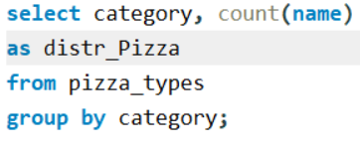
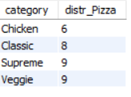
8. Join relevant tables to find the category-wise distribution of pizzas

Slide 14
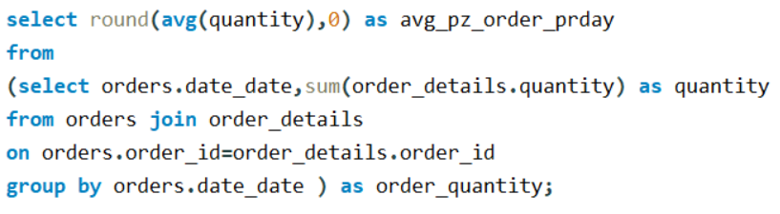
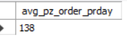
9. Group the orders by date and calculate the average number of pizzas ordered per day.

Slide 15
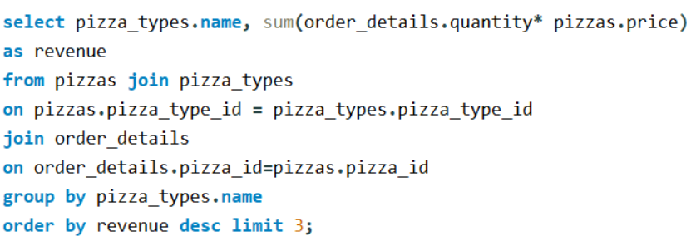
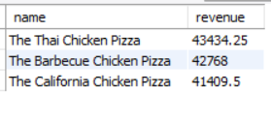
10. Determine the top 3 most ordered pizza types based on revenue.

Slide 16
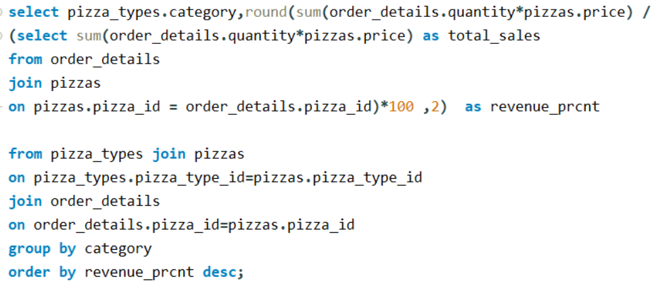
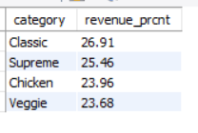
11. Calculate the percentage contribution of each pizza type to total revenue.

Slide 17
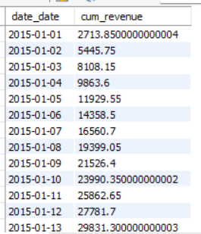
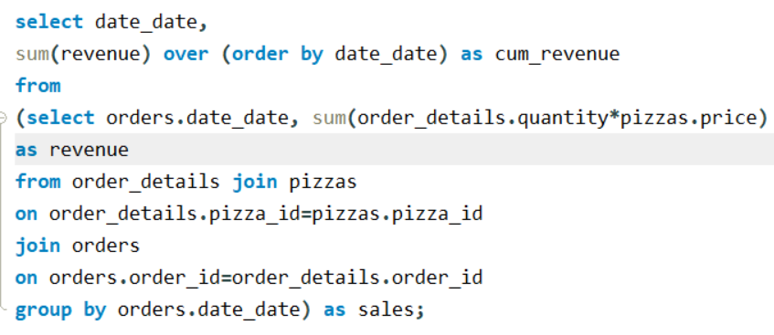
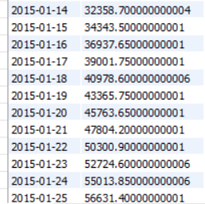
12.Analyze the cumulative revenue generated over time.

Slide 18
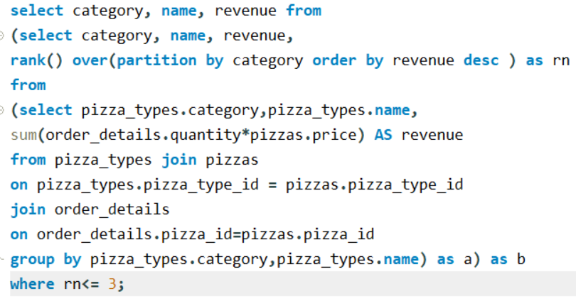
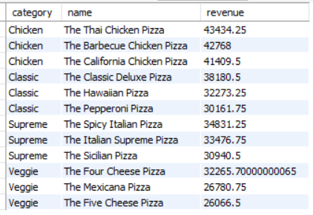
13. Determine the top 3 most ordered pizza types based on revenue for each pizza category.

Slide 19





THANK YOU!
SRUTHIKA BEKKUNUTI
Sruthika0727@gmail.com
www.linkedin.com/in/contact-sruthika

